Slide 1
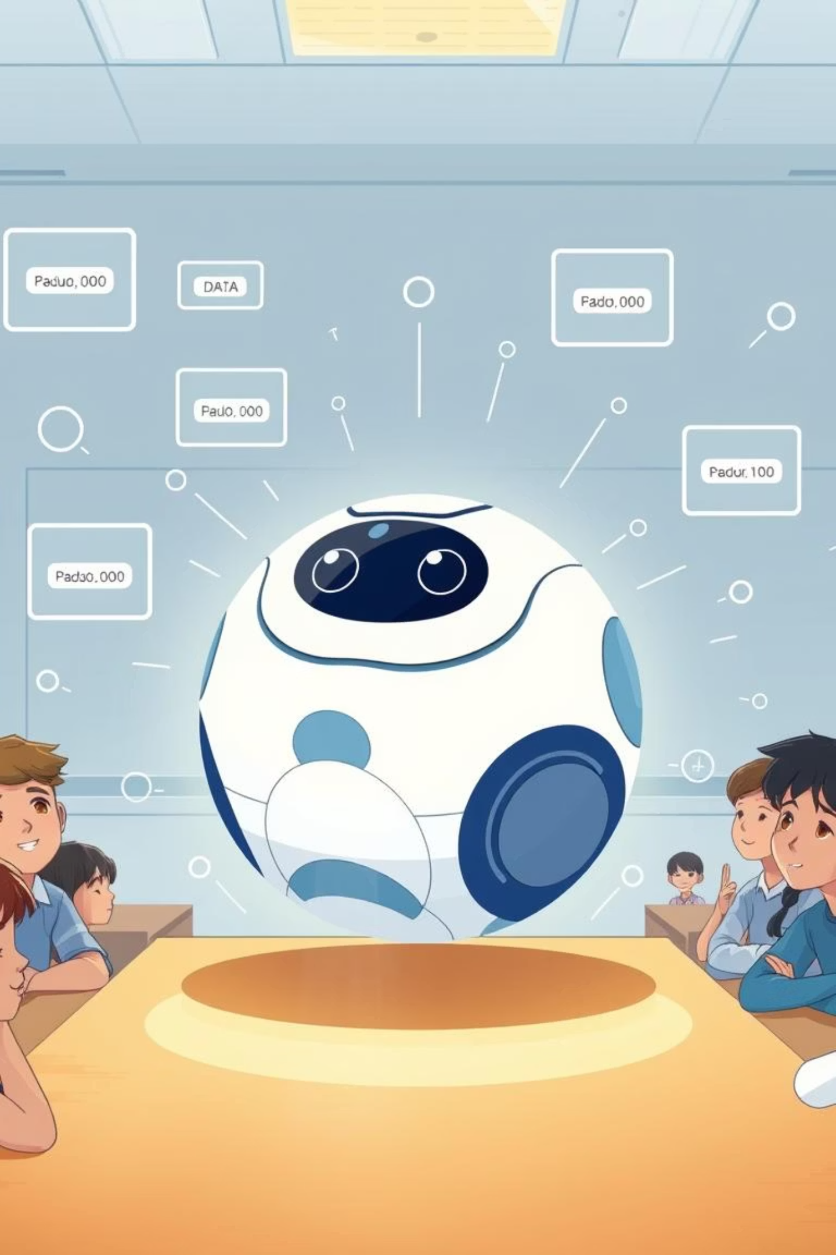
LESSON 5: VARIABLES & DATA STORAGE
Notes:
Link to Sphero Edu Program
https://drive.google.com/file/d/1mUXXsuAHMt9L4rLGq0V1Ng_PnEzzVKoL/view?usp=drive_link

Slide 2

Notes:
Can take a photo for their House Captains page

Slide 3
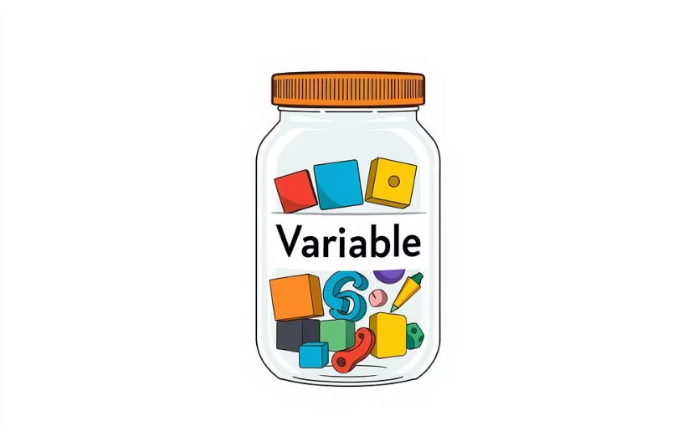
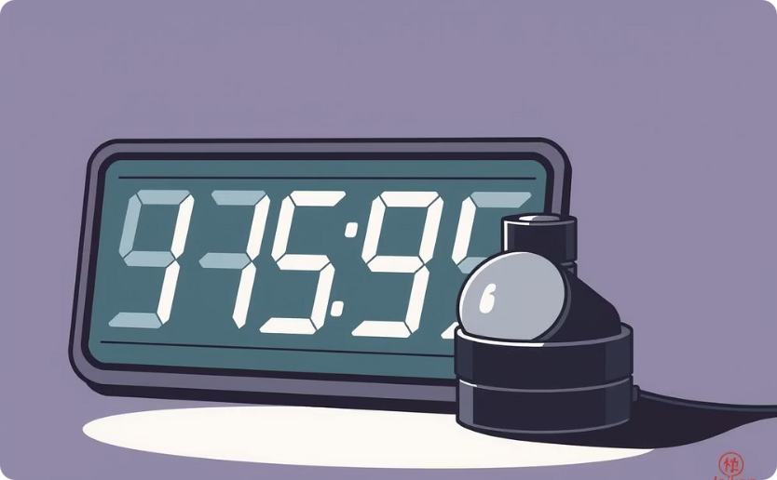
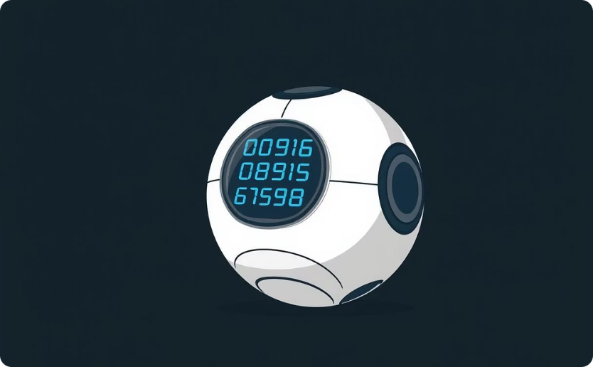
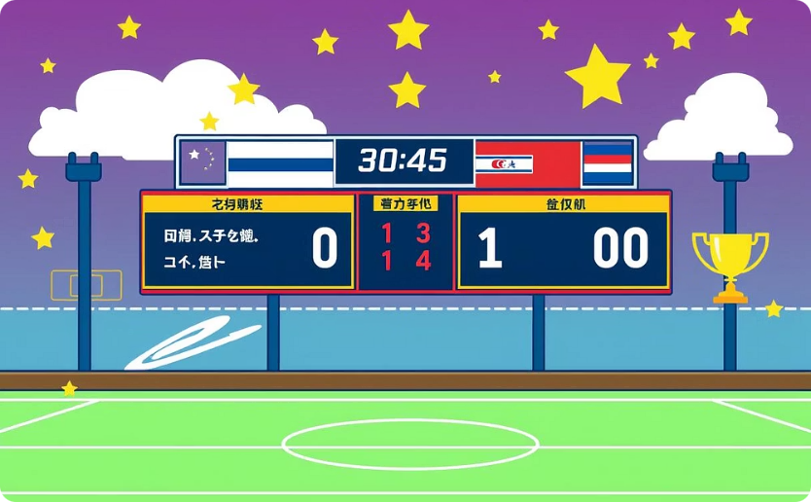
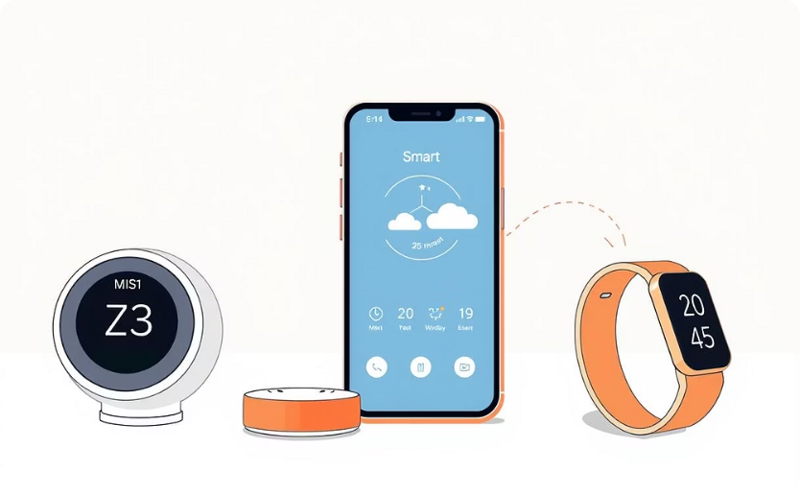
Core Objectives
Understanding Variables
Counting Systems
Displaying Data
Building Scoring
Variables are containers that store changing information.
Create event-driven counting systems using variables.
Display variable values on Sphero's matrix display.
Build scoring systems that track multiple types of data.
Real-World Use
Recognize how devices around us use variables to remember things.
Notes:
Link to Sphero Edu Program
https://drive.google.com/file/d/1mUXXsuAHMt9L4rLGq0V1Ng_PnEzzVKoL/view?usp=drive_link

Slide 4

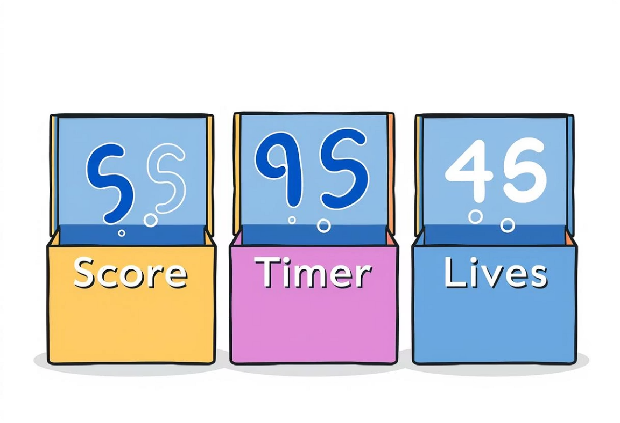



What are Variables?
Variables: Your Program's Memory
Think of variables like labeled boxes that can hold different information. Just like you might label a box for "toys" or "books," programs use variables to label and store specific types of data. Here are some common examples:
Score Box
Timer Box
Lives Box
This box holds your current points, like 0, 5, 23, or 150.
This box keeps track of time, such as seconds elapsed (0, 1, 2, 3...).
This box stores the number of remaining attempts, like 3, 2, 1, or 0.

Slide 5


Why Do We Need Variables?
Without Variables: Instant Forgetfulness
With Variables: Memory and Progress
A collision happens, the program reacts by flashing red, but then immediately forgets that anything happened. No record, no progress.
A collision occurs, the program flashes red, and then adds 1 to a "collision count" variable. It remembers the total, allowing for game progression or tracking.

Slide 6





Real-World Examples
Think about your phone – it constantly uses variables to remember essential information:
Battery Level
Unread Messages
Tracks how much power is left, so you know when to charge.
Remembers how many new texts or emails you've received.
Step Count
Screen Brightness
Keeps a running tally of your daily activity for fitness tracking.
Stores your preferred display setting or adjusts automatically.
Think About It: How does your favorite game remember your high score even after you turn it off?

Slide 7
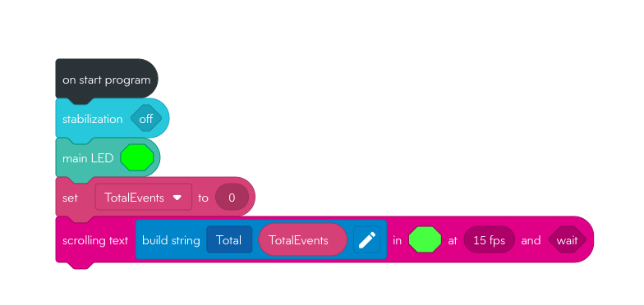
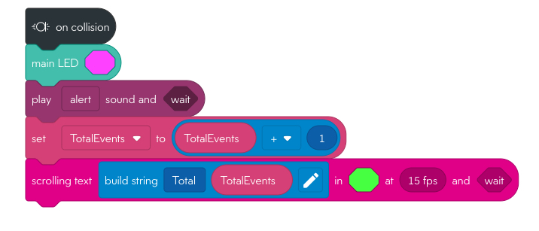
Core Activity: Building Your Event Counter
Your Challenge: Create an Event Scoring System
Build on your Lesson 4 event skills! Make Sphero count and remember how many times each event happens.
[On Collision]
[Start Program]
Add 1 to "Total Events"
Create variable "Total Events" = 0
Flash red twice
Set main LED to green
💥 When a Collision Happens
The robot turns on its light again.
It plays a sound to say “I hit something!”
Then comes the important part:
➕ Why We Need TotalEvents = TotalEvents + 1
This line means:
“Take the current number of collisions, and add 1 to it.”
So if the robot had already hit something 3 times, this line changes the count to 4.
Without this line, the robot would never update the count — it would always say “Total 0” no matter how many times it bumped into things.
Display new score on matrix
Display "Score: 0" on matrix
Play "ding" sound
🟢 When the Program Starts
It turns off stabilization (so the robot can move freely).
It turns on its main light.
It creates a counter called TotalEvents and sets it to 0.
It shows a message like: "Total 0" — meaning no collisions have happened yet.
Notes:
Extended notes —> Zoom out When you create a variable make sure it's set to number not a string. You will have to give name then choose a value e.g number before you can tick/create variable
The build string block is in the maths category - you will have to use the pen to edit the string to accept numbers - the build string will not accepts the variable unless you set this
Common Student Error : When they create or ‘set’ a variable they will set it as a string and not a number out of all the values you can set the variable as ‘string’ is the first in the list - this will not be able store a score or a reading from the sensors - you will be able to see if they create a string variable because the value will be a rectangle box shop and not a circular shape with a number inside it
Link to Sphero Edu Program
https://drive.google.com/file/d/1mUXXsuAHMt9L4rLGq0V1Ng_PnEzzVKoL/view?usp=drive_link

Slide 8




Mini Plenary: Check Your Understanding
Let's recap what you've learned. Discuss these questions with your partner:
Total Events Variable
Program Restart
What specific information does your "Total Events" variable store?
What happens if you restart your program? Why does the score reset?
Lesson 4 Differences
Counting Collisions
How is this program different from your Lesson 4 programs that only flashed colors?
If you only wanted to count collisions, what specific changes would you make?

Slide 9
[On Landing]
[On Freefall]
Add 1 to "Total Events"
Add 1 to "Total Events"
Show new color
Show new color
Display new score on matrix
Display new score on matrix
Play a sound
Play a sound
Build a string to show acceleration
Build a string to show velocity
Success Check:
□ Variable increases each time an event happens
□ Score displays correctly on matrix after each event
□ You can trigger 10+ events and see the count grow
Notes:
Solutions on next page - warn students that if they are both connected when program run will glitch. Choose one and test, before trying to write the other. More able students should recognise they just duplicate the code from on collision. To up level add the total accelerometer sensor to show impact (g) on landing and total velocity sensor to string on freefall
Simple work around
when start program test either on freefall or on landing - just disconnect code from event handler

Slide 10
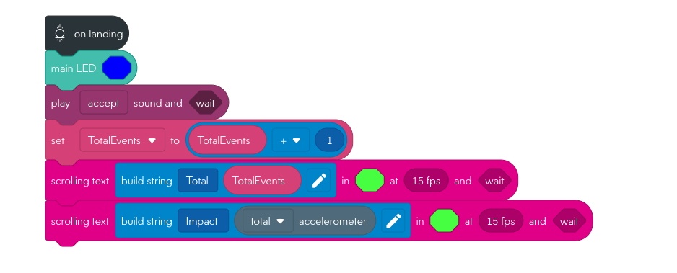
✅ What the Program Does
Trigger: It runs when the robot lands (using the "on landing" event).
Actions:
Turns on the main LED.
Plays a sound.
Adds 1 to the variable TotalEvents.
Displays two scrolling messages:
One showing the updated total number of landings.
One showing the impact value from the accelerometer.
🧪 Key Things That Make It Work
The variable TotalEvents must be created beforehand (usually in the "on start" block).
The robot must be able to detect a landing event — this depends on how it's being used (e.g., dropped, bumped, or rolled).
The accelerometer must be active and able to measure impact.
🛠️ Suggestions to Ensure It Works
If you're testing this in class:
Make sure the robot is moving in a way that triggers the landing sensor.
Use the "on start" block to initialize TotalEvents to 0.
Test with small drops or bumps to see if the landing event is triggered.
[On Landing] Solution
Notes:
Extended notes —> Zoom out —> Left

Slide 11
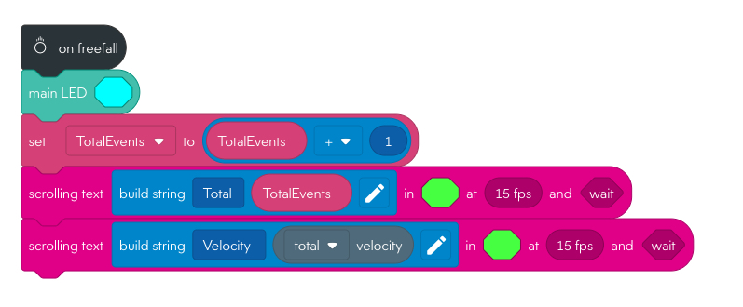
🧠 What It Does
Detects a fall using the robot’s motion sensor.
Turns on the main LED (light).
Adds 1 to a counter called TotalEvents — this keeps track of how many times the robot has fallen.
Shows a message on the robot’s screen:
First message: “Total [number of falls]”
Second message: “Velocity [how fast it was falling]”
🧪 What You’re Teaching
Sensors detect motion (falling).
Variables store data (how many falls).
Outputs show results (light and scrolling messages).
[On Freefall] Solution
Notes:
Extended notes —> Zoom out and to your left

Slide 12
Prove Your Variable Mastery!
Assessment Questions:
How do variables help programs remember information between events?
What's the difference between a number in your program (like "5") and a variable?
Why might games need multiple variables instead of just one?
How could variables improve your previous Sphero programs?
Exit Ticket - Complete These:
Variables are like _________ that can hold different _________
One real-world device that uses variables to count things: _________
The most useful thing about variables is: _________

Slide 13




Prove It Task - Choose One:
Demonstrate
Show your event counter and explain how the variable changes.
Design
Create a different type of counting system (timer, lives, attempts).
Test
Help a classmate debug their variable program.
Extend
Add an IF statement that does something special when your variable reaches 10.
Next Lesson Preview:
Integration & Game Development - You'll combine events, variables, IF statements, and loops to create complete interactive games that others can play!

